Slide 1

Data Structure Design
Problem Solving
Wonhee Cho
Student ID: 20153129

Slide 2
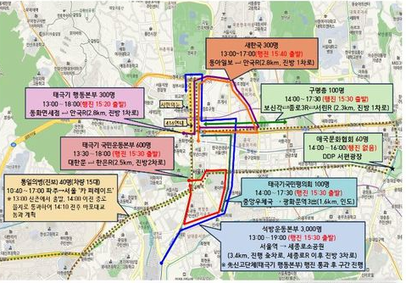
Previous ppt Recapitulation
Node :
Intersection
Edge :
Road between intersections
Weight :
Road length
Orientation :
Parade’s Direction
(Can be bi-directional)
Dynamic Issues :
Changing nodes over time

Slide 3
Problem Solving
Software Type : PC Program
Language : Java
Display : GUI using a map image as background
Dynamic Graph : Nodes(Circle) + Edges(Arrows) on JPanel
Data Input : Excel file
Manipulation : Time manipulating and etc buttons as JButtons
Data Structure : HashMap<Nodes, ArrayList<Edges>>
Design Pattern : Model-View-Controller

Slide 4
Problem Solving - Display
Display : GUI using a map image as background
Dynamic Graph : Nodes(Circle) + Edges(Arrows) on JPanel

Slide 5
Bibliography
http://www.newsis.com/view/?id=NISX20180202_0000220913

Slide 6
Q&A
Problem Definition and Modeling

